Slide 1
Probability and Bayesian Networks
Santosh GSK and Bharat Varma
Industry Experts

Slide 2
Agent Architecture Recap
Simple Reflex Agent
Model based Agent
Goal based Agent
Utility based Agent
Learning based Agent
Model-based agents, i.e., relies on a knowledge representation of the world

Slide 3
Agent Architecture
Knowledge Representation
Representation of world’s knowledge into machine readable format

Slide 4
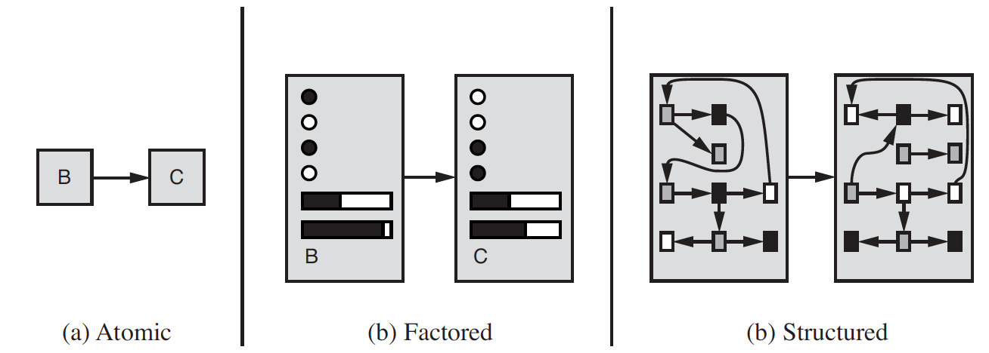
Complexity of Representation
What my actions do?
Search Strategies
Propositional Logic
First Order Logic

Slide 5
Knowledge-based Agents
Solving problems by
Representing the knowledge in state-space
Reasoning about the solution in logical steps
Propositional Logic
Facts
With values [0, 1]
First order Logic
Facts, Objects, Relations
With values [0, 1]

Slide 6
Facts
Delhi is the capital of India
You can reach Bangalore Airport from MG Road within 90 mins if you go by route A.
Would you call that as a fact?
Are you sure this would be true always?
Depends on time of the day, day of the week, is it raining, etc.
Such problems are called “Quantification problems”

Slide 7
Uncertainty
You can reach Bangalore Airport from MG Road within 90 mins if you go by route A.
There is uncertainty in this information due to partial observability and non determinism
Agents should handle such uncertainty
Previous approaches like Logic represent all possible world states
Such approaches can’t be used as multiple possible states need to be enumerated to handle the uncertainty in our information

Slide 8
Belief
You can reach Bangalore Airport from MG Road within 90 mins if you go by route A.
Such information can only provide a degree of belief, e.g., we are 80% confident that it would be true on any given day
In order to deal such degree of belief, we need Probability Theory

Slide 9
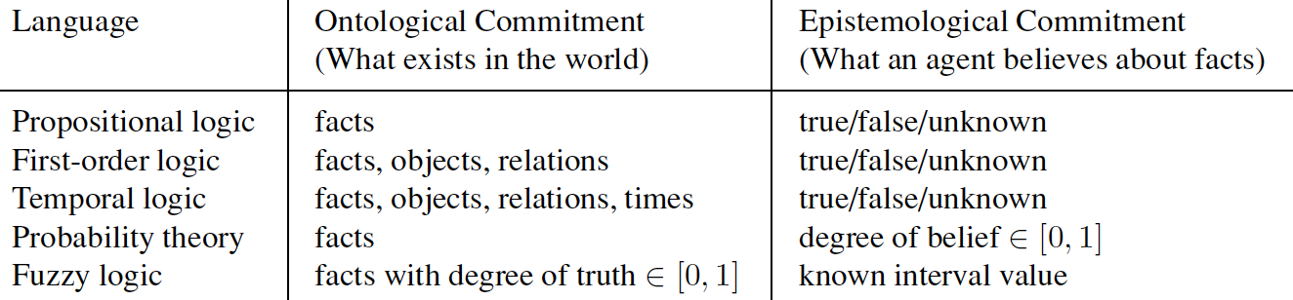
Knowledge Representation

Slide 10
Probability Theory
Probability provides a way to summarize the uncertainty
You can reach Bangalore Airport from MG Road within 90 mins if you go by route A.
If we know that it is evening, the Probability of the statement can be 0.4
Based on available information the Probability would capture the belief better

Slide 11
Statistics & Probability
Statistics – Statistics provides a way of organizing data to extract information on a wider and objective basis than relying on personal experience.
Analyse the past events
Probability – Predict the likelihood of a future event
Questions addressed:
Statistics – How ideal is the world?
Probability – What will happen in a given ideal world?

Slide 12
Probability Basics – Sample Space
Sample Space: Set of all possible outcomes.
Ex: After tossing 2 coins, the set of all possible outcomes are
{HH, HT, TH, TT}
Event: A subset of a sample space.
An event of interest might be - {HH}

Slide 13
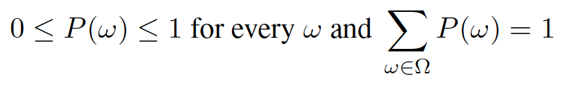
Probability Basics – Probability Model
A fully specified probability model associates a numerical probability P(ω) with each possible world.
The basic axioms
Every possible world has a probability between 0 and 1
Sum of probabilities of possible worlds is 1
E.g., P(HH) = 0.25; P(HT) = 0.25; P(TT) = 0.25, P(TH) = 0.25

Slide 14
Probability Basics – Exclusive / Exhaustive events
Mutually Exclusive Events:
Two events (or propositions) are mutually exclusive or disjoint if they cannot both occur at the same time(be true).
A clear example is the set of outcomes of a single coin toss, which can result in either heads or tails, but not both.
Exhaustive Events:
A set of events is jointly or collectively exhaustive if at least one of the events must occur.
E.g., when rolling a six-sided die, the events 1, 2, 3, 4, 5, and 6 are collectively exhaustive.

Slide 15
Probability Basics - Propositions
Probabilistic assertions (Propositions)
Usually not a particular world event but about a set of them
E.g., two dice when rolled, a proposition φ can be “the sum of dice is 11”
For any proposition φ,
P(φ) = P(sum = 11) = P((5, 6)) + P((6, 5))
= 1/36 + 1/36 = 1/18

Slide 16
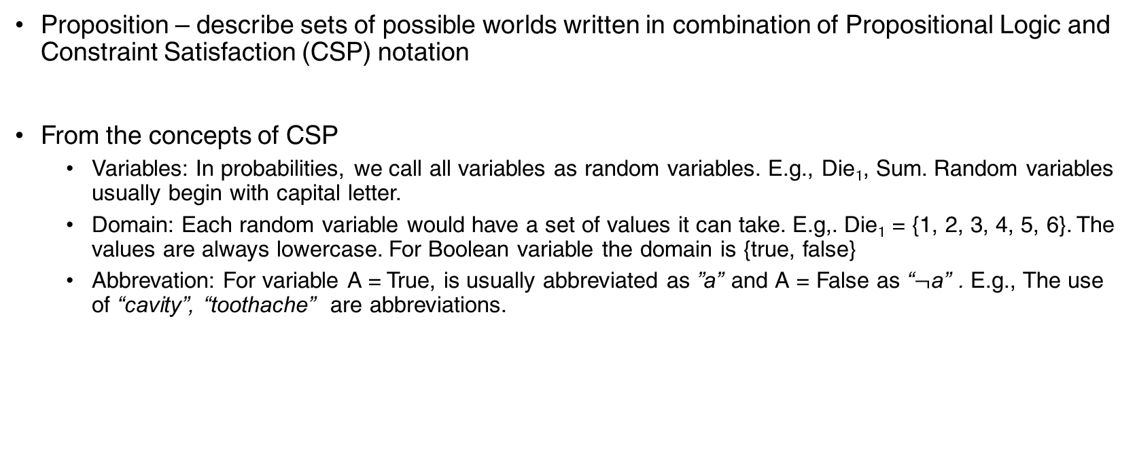
Probability Assertions and Propositions
Proposition – describe sets of possible worlds written in combination of Propositional Logic and Constraint Satisfaction (CSP) notation
From the concepts of CSP
Variables: In probabilities, we call all variables as random variables. E.g., Die₁, Sum. Random variables usually begin with capital letter.
Domain: Each random variable would have a set of values it can take. E.g,. Die₁ = {1, 2, 3, 4, 5, 6}. The values are always lowercase. For Boolean variable the domain is {true, false}
Abbrevation: For variable A = True, is usually abbreviated as ”a” and A = False as “$¬$a” . E.g., The use of “cavity”, “toothache” are abbreviations.

Slide 17
Probability Basics – Unconditional / Prior
Unconditional / Prior probabilities: Propositions like P(sum = 11) or P(two dices rolling equals) are called Unconditional or Prior probabilities
They refer to degree of belief in absence of any other information

Slide 18
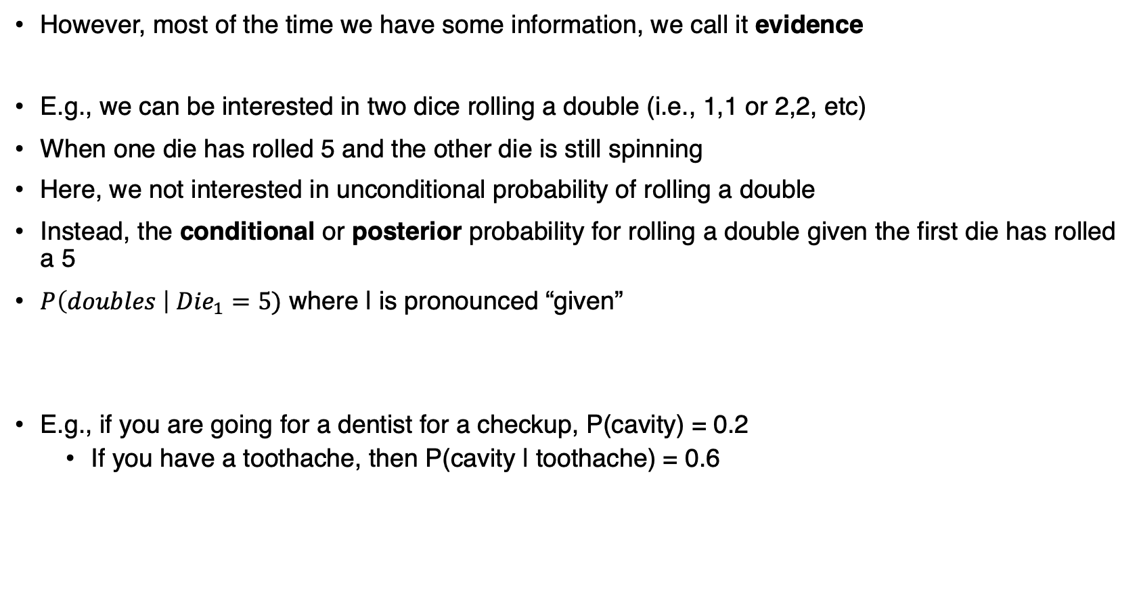
Probability Basics - Conditional
However, most of the time we have some information, we call it evidence
E.g., we can be interested in two dice rolling a double (i.e., 1,1 or 2,2, etc)
When one die has rolled 5 and the other die is still spinning
Here, we not interested in unconditional probability of rolling a double
Instead, the conditional or posterior probability for rolling a double given the first die has rolled a 5
$P\left(doubles \right| {Die}_{1}=5)$ where | is pronounced “given”
E.g., if you are going for a dentist for a checkup, P(cavity) = 0.2
If you have a toothache, then P(cavity | toothache) = 0.6

Slide 19
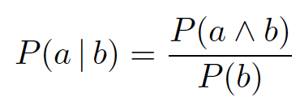
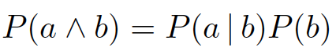
Probability Basics - Conditional
Conditional probabilities can be expressed in unconditional probabilities
E.g., for proposition a, b
Holds when P(b) > 0
Product rule :

Slide 20
Probability Distribution
If there is a random variable Weather with domain {sunny, rain, cloudy, snow}, we could write
P(Weather = sunny) = 0.6
P(Weather = rain) = 0.1
P(Weather = cloudy) = 0.2
P(Weather = snow) = 0.1
P(Weather) = <0.6, 0.1, 0.2, 0.1>
P defines a probability distribution for the random variable Weather
P is used for conditional distributions; P(X|Y) gives values for P(X = i | Y = j) for all combinations of i and j

Slide 21
Probability Density Function
For continuous variables (e.g., weight) it is infeasible to write the distribution as a vector
Instead, we define the probability as a function of the value the variable can take
P(Weight = x) = Normal(x | mean = 60, std = 10)
It says that the weight of an individual is Normal (Gaussian) distributed with average weight being 60 kgs and a deviation of 10 kgs
They are called as Probability Density Function

Slide 22
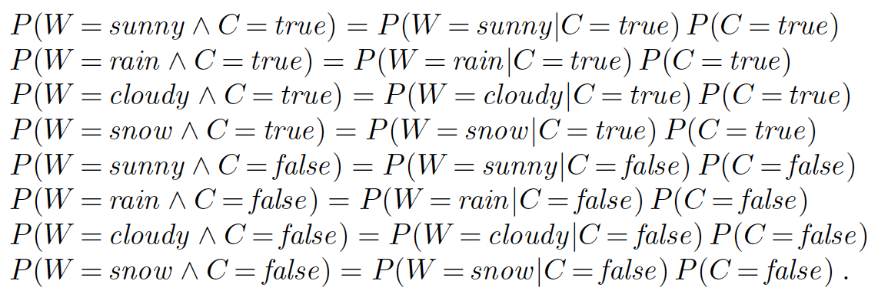
Joint Probability Distributions
Instead of distribution over single variable, we can model distribution over multiple variables, separated by comma
E.g., P(A, B) = P(A | B) . P(B)
P(A, B) is the probability distribution over combination of all values of A and B
E.g., if A = Weather and B = Cavity

Slide 23
Full Joint Probability Distribution
A probability model is completely determined by the joint distribution for all of random variables – full joint probability distribution
E.g., P(Catch, Cavity, Toothache)
Can be represented by 2x2x2 table to represent all combinations of the variables with values corresponding to the probabilities of seeing those combinations respectively.

Slide 24
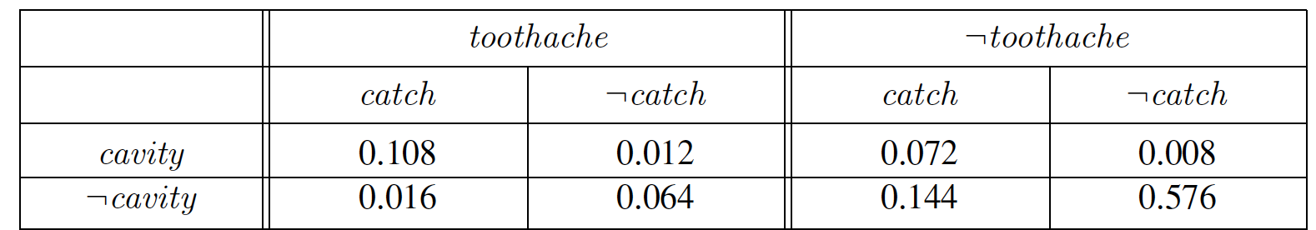
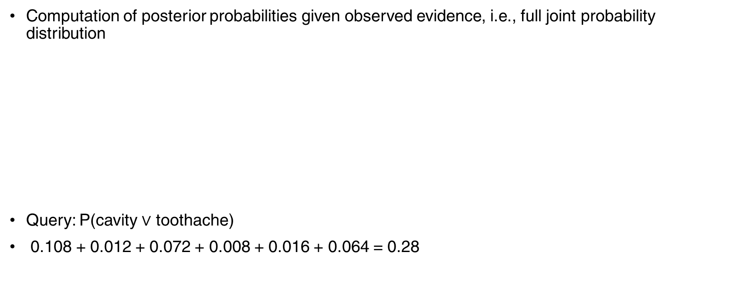
Probabilistic Inference
Computation of posterior probabilities given observed evidence, i.e., full joint probability distribution
Query: P(cavity $∨$ toothache)
0.108 + 0.012 + 0.072 + 0.008 + 0.016 + 0.064 = 0.28

Slide 25
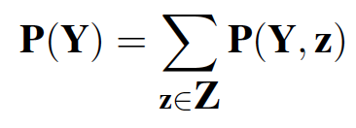
Probabilistic Inference: Marginalization
Query: P(cavity)
P(cavity) = 0.108 + 0.012 + 0.072 + 0.008 = 0.2
This process is called marginalization or summing out – as we sum up probabilities for each possible value of other variable so that we take them out of equation

Slide 26
Probability Basics – Marginal Probability
Marginal Probability: The probability of an event occurring p(A). It may be thought of as an unconditional probability. It is not conditioned on another event.
Ex: From a deck of cards, the probability that a card drawn is red
p(red) = 0.5
From a deck of cards, the probability that a card drawn is a 4
p(four)=1/13

Slide 27
Independence
If we have two random variables, TimeToBnlrAirport and HyderabadWeather
P(TimeToBnlrAirport, HyderabadWeather)
To determine their relation, use the product rule
= P(TimeToBnlrAirport | HyderabadWeather) / P(HyderabadWeather)
However, we would argue that HyderabadWeather and TimeToBnlrAirport doesn’t have any relation and hence
P(TimeToBnlrAirport | HyderabadWeather) = P(TimeToBnlrAirport)
This is called Independence or Marginal Independence
Independence between propositions a and b can be written as

Slide 28
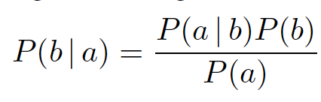
Bayes Rule
Using the product rule for propositions a and b
Equating the right hand sides and dividing by P(a)
This is called the Bayes Rule

Slide 29
Conditional Independence
2 random variables A and B are conditionally independent given C iff
P(a, b | c) = P(a | c) P(b | c) for all values a, b, c
More intuitive (equivalent) conditional formulation
A and B are conditionally independent given C iff
P(a | b, c) = P(a | c) OR P(b | a, c) =P(b | c), for all values a, b, c
Intuitive interpretation:
P(a | b, c) = P(a | c) tells us that learning about b, given that we already know c, provides no change in our probability for a, i.e., b contains no information about a beyond what c provides

Slide 30
Conditional Independence
Can generalize to more than 2 random variables
E.g., K different symptom variables X1, X2, … XK, and C = disease
P(X1, X2,…. XK | C) = Π P(Xi | C)
Also known as the naïve Bayes assumption

Slide 31
Bayesian Networks
In Probabilities, we have seen that random variables can be related with joint distribution, conditionality, independence, etc.
However, such relations are defined in a formal semantics using a network topology and probabilities
Bayesian Networks is a field that represents such relations systematically
We explore the use of probability theory to objects and relations (like in first-order logic)

Slide 32
Bayesian Networks
Full joint probability distributions can be used for inference however can become intractable as the number of variables grow
Bayesian Networks represent dependencies among variables
Can represent full joint probability distribution

Slide 33
What is a Bayesian Network
A Bayesian network is a directed graph in which each node is annotated with quantitative probability information.
Each node corresponds to a random variable, which may be discrete or continuous.
A set of directed links or arrows connects pairs of nodes. If there is an arrow from node X to node Y , X is said to be a parent of Y. The graph has no directed cycles (and hence is a directed acyclic graph, or DAG).
Each node X_{i} has a conditional probability distribution P(X_{i} | Parents(X_{i} )) that quantifies the effect of the parents on the node.

Slide 34
Bayesian Networks
Once the topology of the Bayesian Network is laid out,
Will specify the conditional probability distribution for each variable given its parents
Such that the topology and conditional probabilities suffices to specify the full joint probability distribution of all variables

Slide 35
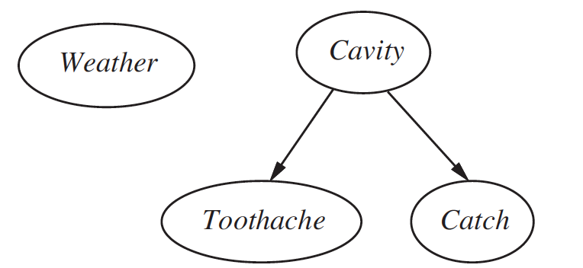
Example Bayesian Net
A simple world with four random variables
Weather, Toothache, Cavity, Catch
Weather is independent of other variables
Toothache and Catch are conditionally independent given Cavity
P(Toothache, Catch | Cavity) = P(Toothache | Cavity ) . P(Catch | Cavity)
Cavity is a direct cause of Toothache and Catch
No direct relation between Toothache and Catch exists

Slide 36
Example Bayesian Net
A Burglary Alarm System
Fairly reliable on detecting a burglary
Also responds to earthquakes
Two neighbors John and Mary are asked to call you at work when Burglary happens and they hear the Alarm
John nearly always calls when he hears the alarm, however sometimes confuses the telephone ring with alarm and calls then too
Mary like loud music and often misses the alarm altogether
Problem: Given the information that who has / has not called we need to estimate the probability of a burglary

Slide 37
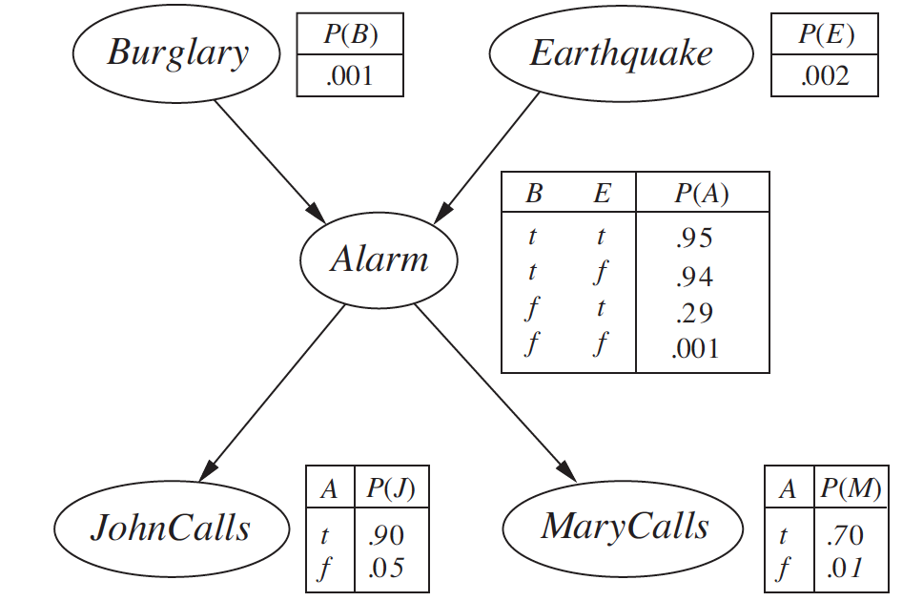
Example Bayes Net: Burglary Alarm
Conditional distributions shown are Conditional Probability Tables (CPT)
Used for discrete variables

Slide 38
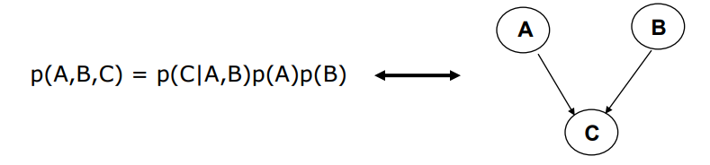
Semantics of Bayesian Nets
Captures Full Joint Distribution of all variables given the topology with conditional distributions
Example: Simple bayesian network with 3 variables

Slide 39
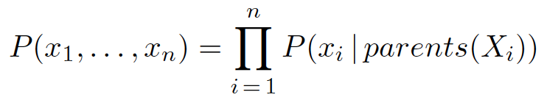
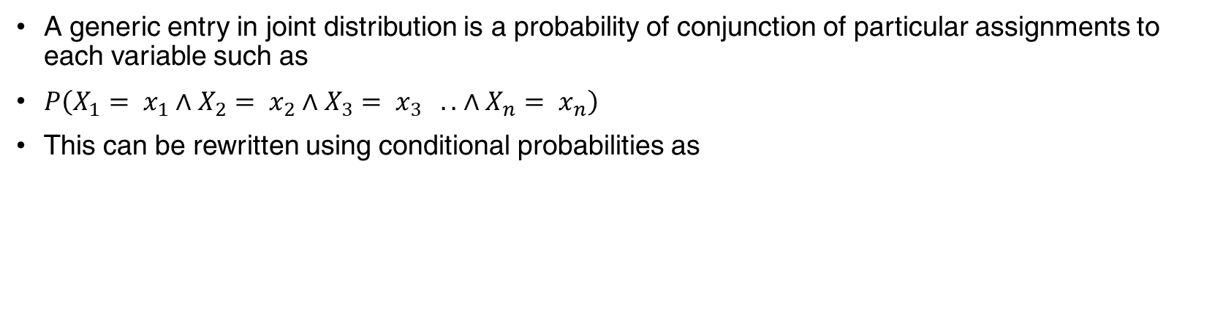
Semantics of Bayesian Nets
A generic entry in joint distribution is a probability of conjunction of particular assignments to each variable such as
$P\left(X_{1}= x_{1}∧X_{2}= x_{2}∧X_{3}= x_{3} . . ∧X_{n}= x_{n}\right)$
This can be rewritten using conditional probabilities as

Slide 40
Example
Calculate the probability that alarm has sounded, but neither burglary nor earthquake happened, and both John and Mary called

Slide 41
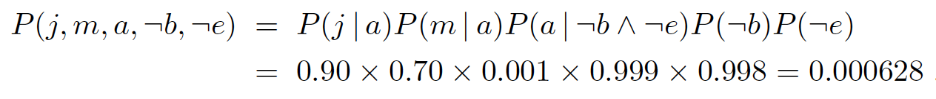
Example

Slide 42
Thank You!
In our next session:
Hidden Markov Models

